Slide 1
MySQL Query Tuning
Database Team
Susmeet Khaire
Friday 12th July 2019
Specify use for internal, external or confidential e.g. For Best Practice use only. [Light 12pt]
[Name of author] (12pt) - file name and author. 2015 © Tyro Payments Limited.

Slide 2
Few quotes to start off…
“Data is the new oil.”
“Torture the data, and it will confess to anything.”
“You can have data without information, but you cannot have information without data.”

Slide 3
What is the need to tune/optimise queries?
We generate more than 200GB data on one database server per month.
To make sense of this data(information), we have to run SQL queries.
These queries need to run fairly and efficiently.
So that it doesn’t affect other activities running on the database.

Slide 4
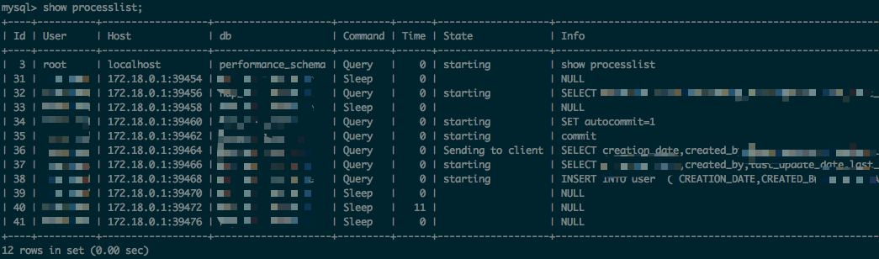
How do we find out?
SHOW PROCESSLIST to check if the query is on going.

Slide 5
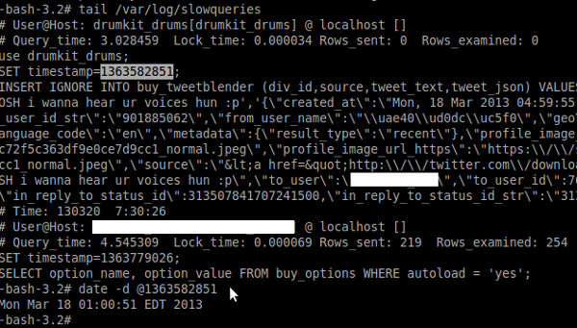
How do we find out?
SLOW QUERY log
If the query has finished execution.
In our setup it is located in /var/log/mysql/mysql-slow.log

Slide 6
How do we find out?
Binary logs to check if a query is replicating slowly but runs fine on master
Primarily used for replicating queries to slaves
We use MIXED format binary logging
Default is Statement based replication
Row based replication if MySQL cannot ensure same result on slaves.
INSERT INTO table SELECT * FROM test_table ORDER BY 1 DESC;
Row based equals one row per result.

Slide 7
How do we find out?
Enable GENERAL logging
last resort as it writes every query to a file
Increases I/O

Slide 8
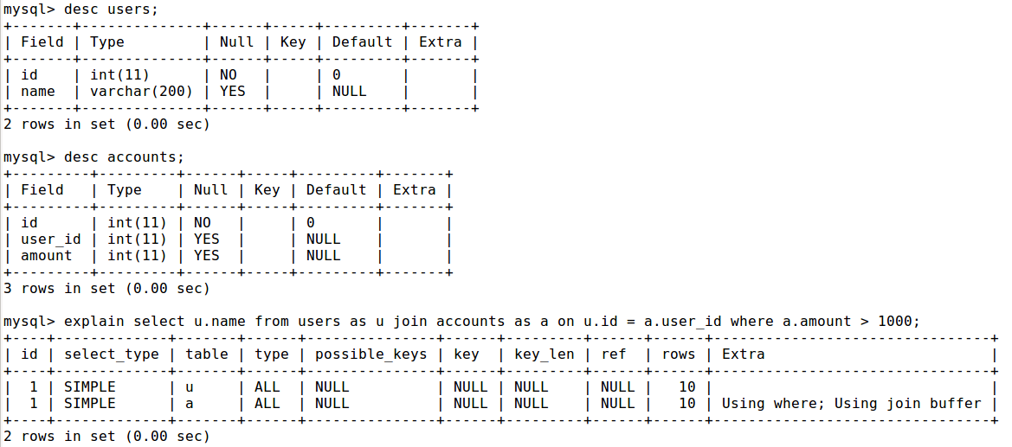
What do we do once we’ve found a slow query?
Run EXPLAIN

Slide 9
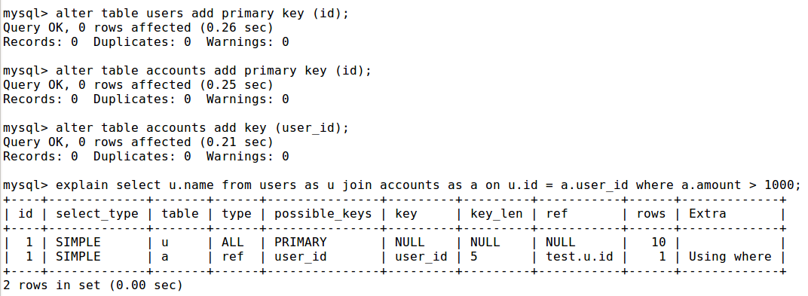

Slide 10
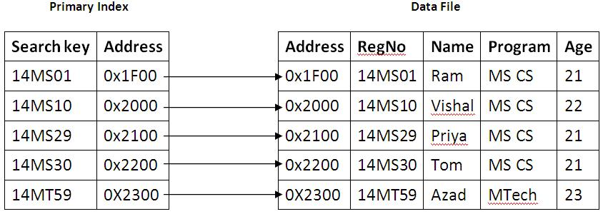
Short intro to indexes

Slide 11
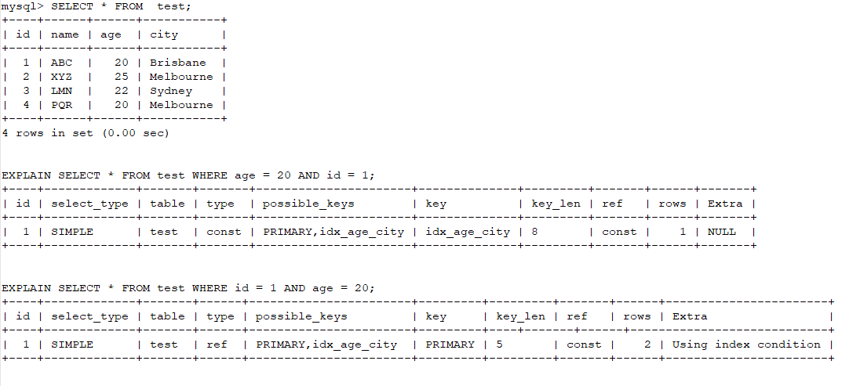
How to tune a query?
REWRITE the query

Slide 12
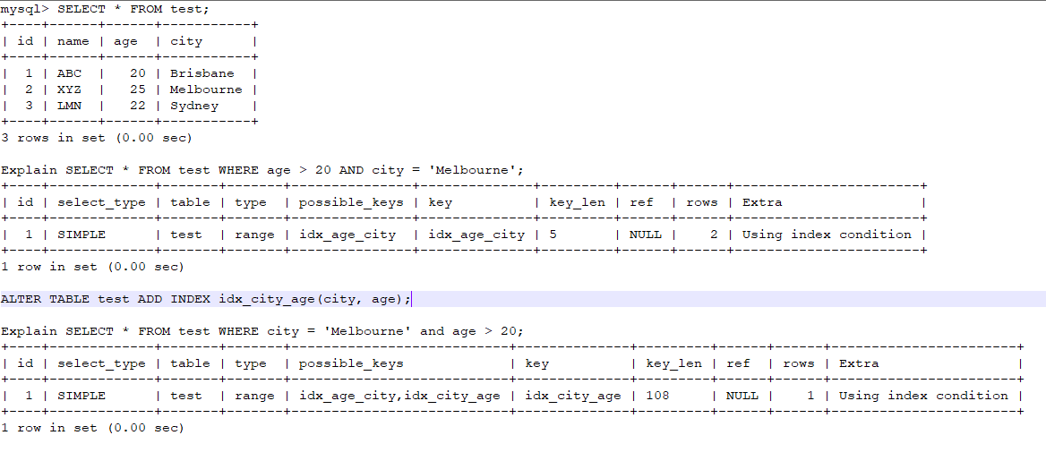
How to tune a query?
Check if we can ADD an index

Slide 13
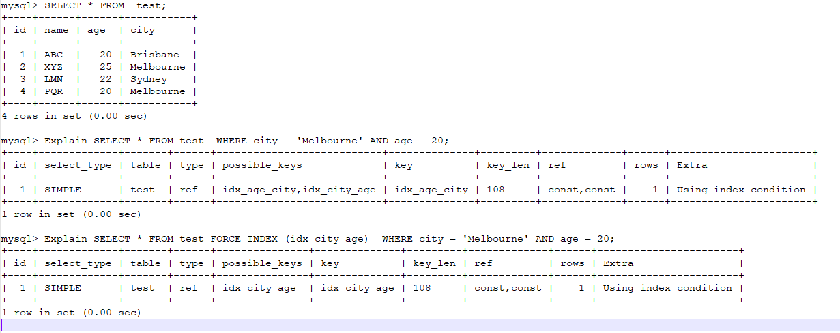
How to tune a query?
Check if we can USE/FORCE index

Slide 14
MySQL 5.6 changes
Innodb_stats_persistent
Innodb_table_stats
Innodb_index_stats
ANALYZE TABLE/ mysqlcheck –a database_name
Risky because of ‘Waiting of table flush’
OPTIMIZE TABLE
recreates entire table

Slide 15
Other problems
Hibernate queries
Complex joins/unions
Solution: Break down in multiple queries

Slide 16
Questions

